Slide 1

Multus-cni
By anishrana2001

Slide 2
By default, Kubernetes supports a single network interface! For some scenario, we need to implement two or three interfaces in the PODs, so that we can connect to different backend services.
Multus is an open-source CNI (Container Network Interface) plug-in for Kubernetes that lets you attach multiple network interfaces to a single pod and associate each with a different address range with the help of CRD objects in Kubernetes. Thus, Multus Containers manages the multiple container network interfaces in Kubernetes.
Role of Multus CNI:
In enabling multi-interface support by serving as a supplementary layer in a container network.
It attaches multiple network interfaces to pods in Kubernetes.
Multus CNI work as an intermediate between container runtime and plugins.
Multus is dependent on other types of network plugins, such as Flannel, Calico, Cilium and Weave.
Moreover, it allows to attach DPDK/SRIOV interfaces to pods to support network intensive workloads

Slide 3
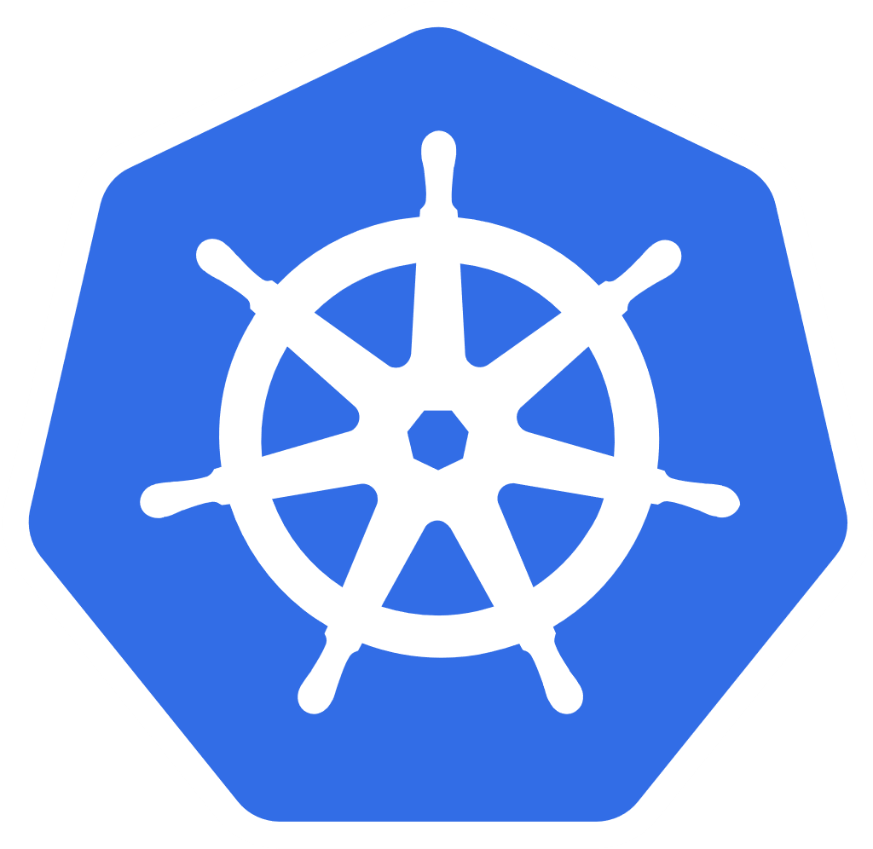
Network1
POD
net0
net1
eth0
Network2

Slide 4
01 NOW WE WILL TALK ABOUT
How to install Multus CNI

Slide 5
[root@master1 ~]# kubectl get network-attachment-definitions.k8s.cni.cncf.io
error: the server doesn't have a resource type "network-attachment-definitions"
[root@master1 ~]# kubectl apply -f https://raw.githubusercontent.com/k8snetworkplumbingwg/multus-cni/master/deployments/multus-daemonset-thick.yml
customresourcedefinition.apiextensions.k8s.io/network-attachment-definitions.k8s.cni.cncf.io created
clusterrole.rbac.authorization.k8s.io/multus created
clusterrolebinding.rbac.authorization.k8s.io/multus created
serviceaccount/multus created
configmap/multus-daemon-config created
daemonset.apps/kube-multus-ds created
[root@master1 net.d]# kubectl get pods -A| grep -i multus
kube-system kube-multus-ds-28dg4 1/1 Running 0 2m43s
kube-system kube-multus-ds-hbddb 1/1 Running 0 2m43s
kube-system kube-multus-ds-tnvgf 1/1 Running 0 2m43s
[root@master1 net.d]# kubectl get network-attachment-definitions.k8s.cni.cncf.io
No resources found in default namespace.

Slide 6
cd /etc/cni/net.d/
[root@master1 net.d]#
cat 00-multus.conf | jq .
{
"capabilities": {
"bandwidth": true,
"portMappings": true
},
"cniVersion": "0.3.1",
"logLevel": "verbose",
"logToStderr": true,
"name": "multus-cni-network",
"clusterNetwork": "/host/etc/cni/net.d/10-calico.conflist",
"type": "multus-shim"
}
[root@master1 net.d]#
Tells each CNI plugin which version is being used

Slide 7
[root@master1 net.d]# cat /etc/cni/net.d/10-calico.conflist
{
"name": "k8s-pod-network",
"cniVersion": "0.3.1",
"plugins": [
{
"type": "calico",
"log_level": "info",
"log_file_path": "/var/log/calico/cni/cni.log",
"datastore_type": "kubernetes",
"nodename": "master1.example.com",
"mtu": 0,
"ipam": {
"type": "calico-ipam"
},
"policy": {
"type": "k8s"
},
"kubernetes": {
"kubeconfig": "/etc/cni/net.d/calico-kubeconfig"
}
},
{
"type": "portmap",
"snat": true,
"capabilities": {"portMappings": true}
},
{
"type": "bandwidth",
"capabilities": {"bandwidth": true}
}
]
}[root@master1 net.d]#
cd /etc/cni/net.d/00-multus.conf
[root@master1 net.d]#
cat 00-multus.conf | jq .
{
"capabilities": {
"bandwidth": true,
"portMappings": true
},
"cniVersion": "0.3.1",
"logLevel": "verbose",
"logToStderr": true,
"name": "multus-cni-network",
"clusterNetwork": "/host/etc/cni/net.d/10-calico.conflist",
"type": "multus-shim"
}
[root@master1 net.d]#
Tells each CNI plugin which version is being used

Slide 8
cd /etc/cni/net.d/00-multus.conf
[root@master1 net.d]#
cat 00-multus.conf | jq .
{
"capabilities": {
"bandwidth": true,
"portMappings": true
},
"cniVersion": "0.3.1",
"logLevel": "verbose",
"logToStderr": true,
"name": "multus-cni-network",
"clusterNetwork": "/host/etc/cni/net.d/10-calico.conflist",
"type": "multus-shim"
}
[root@master1 net.d]#
# Tells each CNI plugin which version is being used
# This tells CNI which binary to call on disk.

Slide 9
[root@master1 ~]# ifconfig
docker0: flags=4099<UP,BROADCAST,MULTICAST> mtu 1500
inet 172.17.0.1 netmask 255.255.0.0 broadcast 172.17.255.255
ether 02:42:4f:74:7d:a6 txqueuelen 0 (Ethernet)
RX packets 0 bytes 0 (0.0 B)
RX errors 0 dropped 0 overruns 0 frame 0
TX packets 0 bytes 0 (0.0 B)
TX errors 0 dropped 0 overruns 0 carrier 0 collisions 0
enp0s3: flags=4163<UP,BROADCAST,RUNNING,MULTICAST> mtu 1500
inet 192.168.1.31 netmask 255.255.255.0 broadcast 192.168.1.255
inet6 fe80::a00:27ff:fe22:8301 prefixlen 64 scopeid 0x20<link>
inet6 2401:4900:1c0a:4e0d:a00:27ff:fe22:8301 prefixlen 64 scopeid 0x0<global>
ether 08:00:27:22:83:01 txqueuelen 1000 (Ethernet)
RX packets 110855 bytes 16897880 (16.1 MiB)
RX errors 0 dropped 0 overruns 0 frame 0
TX packets 131686 bytes 82851882 (79.0 MiB)
TX errors 0 dropped 0 overruns 0 carrier 0 collisions 0
lo: flags=73<UP,LOOPBACK,RUNNING> mtu 65536
inet 127.0.0.1 netmask 255.0.0.0
inet6 ::1 prefixlen 128 scopeid 0x10<host>
loop txqueuelen 1000 (Local Loopback)
RX packets 2456806 bytes 463770856 (442.2 MiB)
RX errors 0 dropped 0 overruns 0 frame 0
TX packets 2456806 bytes 463770856 (442.2 MiB)
TX errors 0 dropped 0 overruns 0 carrier 0 collisions 0
tunl0: flags=193<UP,RUNNING,NOARP> mtu 1480
inet 172.16.68.0 netmask 255.255.255.255
tunnel txqueuelen 1000 (IPIP Tunnel)
RX packets 0 bytes 0 (0.0 B)
RX errors 0 dropped 0 overruns 0 frame 0
TX packets 0 bytes 0 (0.0 B)
TX errors 0 dropped 0 overruns 0 carrier 0 collisions 0

Slide 10
cat <<EOF | kubectl create -f -
apiVersion: "k8s.cni.cncf.io/v1"
kind: NetworkAttachmentDefinition
metadata:
name: macvlan-conf
spec:
config: '{
"cniVersion": "0.3.1",
"type": "macvlan",
"master": "enp0s3",
"mode": "bridge",
"ipam": {
"type": "host-local",
"subnet": "192.168.1.0/24",
"rangeStart": "192.168.1.200",
"rangeEnd": "192.168.1.216",
"routes": [
{ "dst": "0.0.0.0/0" }
],
"gateway": "192.168.1.1"
}
}'
EOF
[root@master1 ~]# ifconfig enp0s3
enp0s3: flags=4163<UP,BROADCAST,RUNNING,MULTICAST> mtu 1500
inet 192.168.1.31 netmask 255.255.255.0 broadcast 192.168.1.255
inet6 fe80::a00:27ff:fe22:8301 prefixlen 64 scopeid 0x20<link>
inet6 2401:4900:1c0a:4e0d:a00:27ff:fe22:8301 prefixlen 64 scopeid 0x0<global>
ether 08:00:27:22:83:01 txqueuelen 1000 (Ethernet)
RX packets 112710 bytes 17176613 (16.3 MiB)
RX errors 0 dropped 0 overruns 0 frame 0
TX packets 133865 bytes 84218338 (80.3 MiB)
TX errors 0 dropped 0 overruns 0 carrier 0 collisions 0
[root@master1 ~]# route -n
Kernel IP routing table
Destination Gateway Genmask Flags Metric Ref Use Iface
0.0.0.0 192.168.1.1 0.0.0.0 UG 100 0 0 enp0s3
172.16.14.64 192.168.1.33 255.255.255.192 UG 0 0 0 tunl0
172.16.68.0 0.0.0.0 255.255.255.192 U 0 0 0 *
172.16.133.128 192.168.1.32 255.255.255.192 UG 0 0 0 tunl0
172.17.0.0 0.0.0.0 255.255.0.0 U 0 0 0 docker0
192.168.1.0 0.0.0.0 255.255.255.0 U 100 0 0 enp0s3
[root@master1 ~]#

Slide 11
[root@master1 ~]# kubectl get network-attachment-definitions.k8s.cni.cncf.io macvlan-conf
NAME AGE
macvlan-conf 56s
[root@master1 ~]# kubectl describe network-attachment-definitions.k8s.cni.cncf.io macvlan-conf
Name: macvlan-conf
Namespace: default
Labels: <none>
Annotations: <none>
API Version: k8s.cni.cncf.io/v1
Kind: NetworkAttachmentDefinition
Metadata:
Creation Timestamp: 2024-05-12T07:25:32Z
Generation: 1
Managed Fields:
API Version: k8s.cni.cncf.io/v1
Fields Type: FieldsV1
fieldsV1:
f:spec:
.:
f:config:
Manager: kubectl-create
Operation: Update
Time: 2024-05-12T07:25:32Z
Resource Version: 252464
UID: 9e259bce-de62-4342-a13c-44807dc6113c
Spec:
Config: { "cniVersion": "0.3.0", "type": "macvlan", "master": "enp0s3", "mode": "bridge", "ipam": { "type": "host-local", "subnet": "192.168.1.0/24", "rangeStart": "192.168.1.200", "rangeEnd": "192.168.1.216", "routes": [ { "dst": "0.0.0.0/0" } ], "gateway": "192.168.1.1" } }
Events: <none>
Notes:
Need to stop camera

Slide 12
02 NOW WE WILL TALK ABOUT
Pod configuration for Multus

Slide 13
cat <<EOF | kubectl create -f -
apiVersion: v1
kind: Pod
metadata:
name: samplepod
annotations:
k8s.v1.cni.cncf.io/networks: macvlan-conf
spec:
containers:
- name: samplepod
command: ["/bin/ash", "-c", "trap : TERM INT; sleep infinity & wait"]
image: alpine
EOF

Slide 14
[root@master1 ~]# kubectl get pods samplepod
NAME READY STATUS RESTARTS AGE
samplepod 1/1 Running 0 28s
[root@master1 ~]# kubectl exec -it samplepod -- /bin/sh
/ # ifconfig
eth0 Link encap:Ethernet HWaddr A6:56:BC:E1:26:AC
inet addr:172.16.14.81 Bcast:0.0.0.0 Mask:255.255.255.255
inet6 addr: fe80::a456:bcff:fee1:26ac/64 Scope:Link
UP BROADCAST RUNNING MULTICAST MTU:1480 Metric:1
RX packets:13 errors:0 dropped:0 overruns:0 frame:0
TX packets:9 errors:0 dropped:1 overruns:0 carrier:0
collisions:0 txqueuelen:0
RX bytes:1912 (1.8 KiB) TX bytes:726 (726.0 B)
lo Link encap:Local Loopback
inet addr:127.0.0.1 Mask:255.0.0.0
inet6 addr: ::1/128 Scope:Host
UP LOOPBACK RUNNING MTU:65536 Metric:1
RX packets:0 errors:0 dropped:0 overruns:0 frame:0
TX packets:0 errors:0 dropped:0 overruns:0 carrier:0
collisions:0 txqueuelen:1000
RX bytes:0 (0.0 B) TX bytes:0 (0.0 B)
net1 Link encap:Ethernet HWaddr 6E:7B:C9:22:6F:B0
inet addr:192.168.1.200 Bcast:192.168.1.255 Mask:255.255.255.0
inet6 addr: fe80::6c7b:c9ff:fe22:6fb0/64 Scope:Link
inet6 addr: 2401:4900:1c0a:4e0d:6c7b:c9ff:fe22:6fb0/64 Scope:Global
UP BROADCAST RUNNING MULTICAST MTU:1500 Metric:1
RX packets:23 errors:0 dropped:0 overruns:0 frame:0
TX packets:19 errors:0 dropped:0 overruns:0 carrier:0
collisions:0 txqueuelen:0
RX bytes:1704 (1.6 KiB) TX bytes:1554 (1.5 KiB)
/ #
cat <<EOF | kubectl create -f -
apiVersion: "k8s.cni.cncf.io/v1"
kind: NetworkAttachmentDefinition
metadata:
name: macvlan-conf
spec:
config: '{
"cniVersion": "0.3.1",
"type": "macvlan",
"master": "enp0s3",
"mode": "bridge",
"ipam": {
"type": "host-local",
"subnet": "192.168.1.0/24",
"rangeStart": "192.168.1.200",
"rangeEnd": "192.168.1.216",
"routes": [
{ "dst": "0.0.0.0/0" }
],
"gateway": "192.168.1.1"
}
}'
EOF

Slide 15
03 NOW WE WILL TALK ABOUT
Pod configuration for 2 Interfaces

Slide 16
cat <<EOF | kubectl create -f -
apiVersion: v1
kind: Pod
metadata:
name: samplepod2
annotations:
k8s.v1.cni.cncf.io/networks: macvlan-conf,macvlan-conf
spec:
containers:
- name: samplepod
command: ["/bin/ash", "-c", "trap : TERM INT; sleep infinity & wait"]
image: alpine
EOF

Slide 17
[root@master1 ~]# kubectl exec pods/samplepod2 -- ifconfig
eth0 Link encap:Ethernet HWaddr EA:08:99:94:CD:45
inet addr:172.16.14.100 Bcast:0.0.0.0 Mask:255.255.255.255
inet6 addr: fe80::e808:99ff:fe94:cd45/64 Scope:Link
UP BROADCAST RUNNING MULTICAST MTU:1480 Metric:1
RX packets:13 errors:0 dropped:0 overruns:0 frame:0
TX packets:8 errors:0 dropped:1 overruns:0 carrier:0
collisions:0 txqueuelen:0
RX bytes:1912 (1.8 KiB) TX bytes:656 (656.0 B)
lo Link encap:Local Loopback
inet addr:127.0.0.1 Mask:255.0.0.0
inet6 addr: ::1/128 Scope:Host
UP LOOPBACK RUNNING MTU:65536 Metric:1
RX packets:0 errors:0 dropped:0 overruns:0 frame:0
TX packets:0 errors:0 dropped:0 overruns:0 carrier:0
collisions:0 txqueuelen:1000
RX bytes:0 (0.0 B) TX bytes:0 (0.0 B)
net1 Link encap:Ethernet HWaddr 0A:4F:D5:FB:85:9F
inet addr:192.168.1.201 Bcast:192.168.1.255 Mask:255.255.255.0
inet6 addr: fe80::84f:d5ff:fefb:859f/64 Scope:Link
inet6 addr: 2401:4900:1c0a:4e0d:84f:d5ff:fefb:859f/64 Scope:Global
UP BROADCAST RUNNING MULTICAST MTU:1500 Metric:1
RX packets:15 errors:0 dropped:0 overruns:0 frame:0
TX packets:19 errors:0 dropped:0 overruns:0 carrier:0
collisions:0 txqueuelen:0
RX bytes:1196 (1.1 KiB) TX bytes:1506 (1.4 KiB)
net2 Link encap:Ethernet HWaddr 2E:0D:1A:4E:15:59
inet addr:192.168.1.202 Bcast:192.168.1.255 Mask:255.255.255.0
inet6 addr: 2401:4900:1c0a:4e0d:2c0d:1aff:fe4e:1559/64 Scope:Global
inet6 addr: fe80::2c0d:1aff:fe4e:1559/64 Scope:Link
UP BROADCAST RUNNING MULTICAST MTU:1500 Metric:1
RX packets:14 errors:0 dropped:0 overruns:0 frame:0
TX packets:18 errors:0 dropped:0 overruns:0 carrier:0
collisions:0 txqueuelen:0
RX bytes:1140 (1.1 KiB) TX bytes:1512 (1.4 KiB)

Slide 19
04 NOW WE WILL TALK ABOUT
LAB

Slide 20
https://paypal.me/anishrana20011

